Slide 2
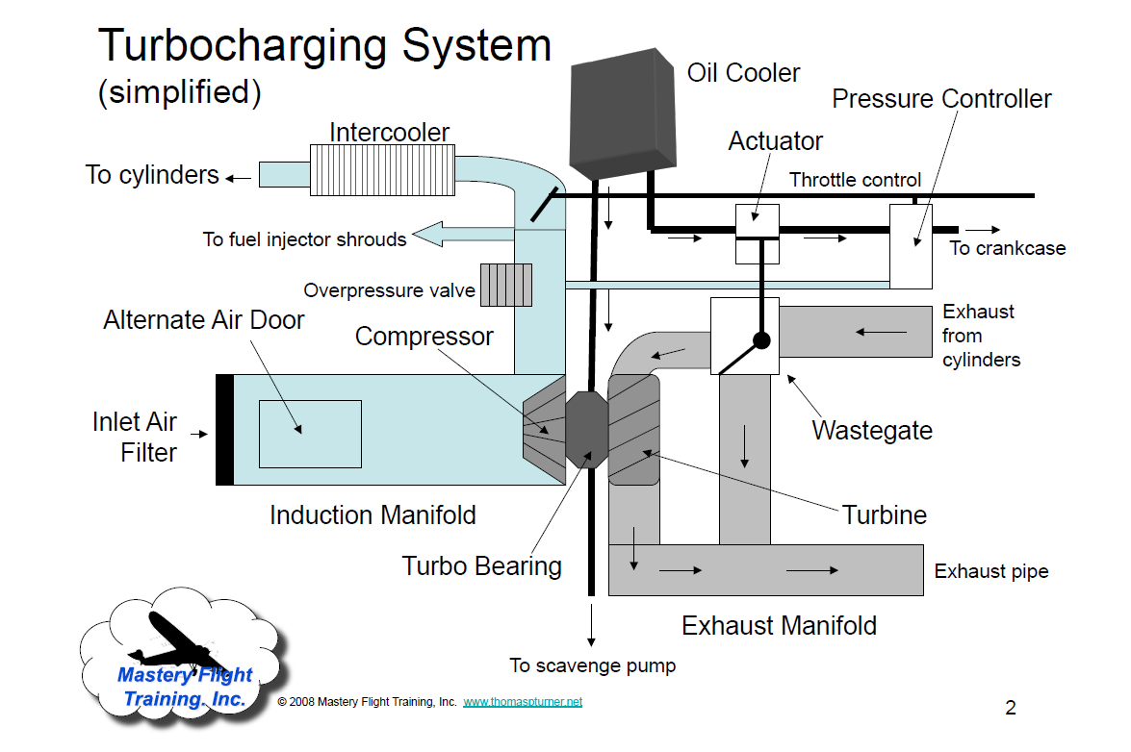

Slide 3
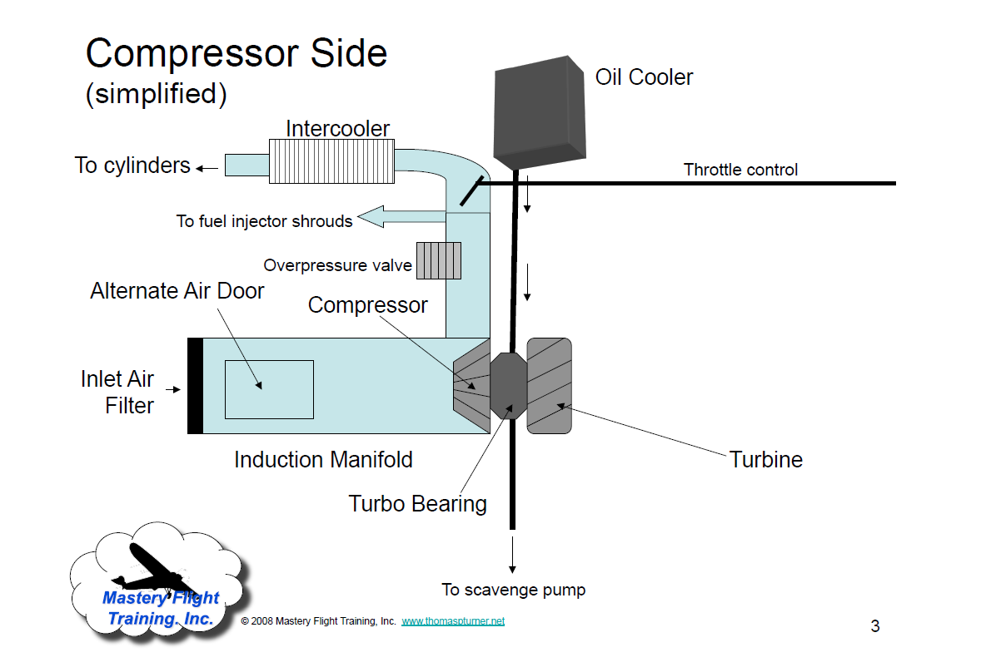

Slide 5
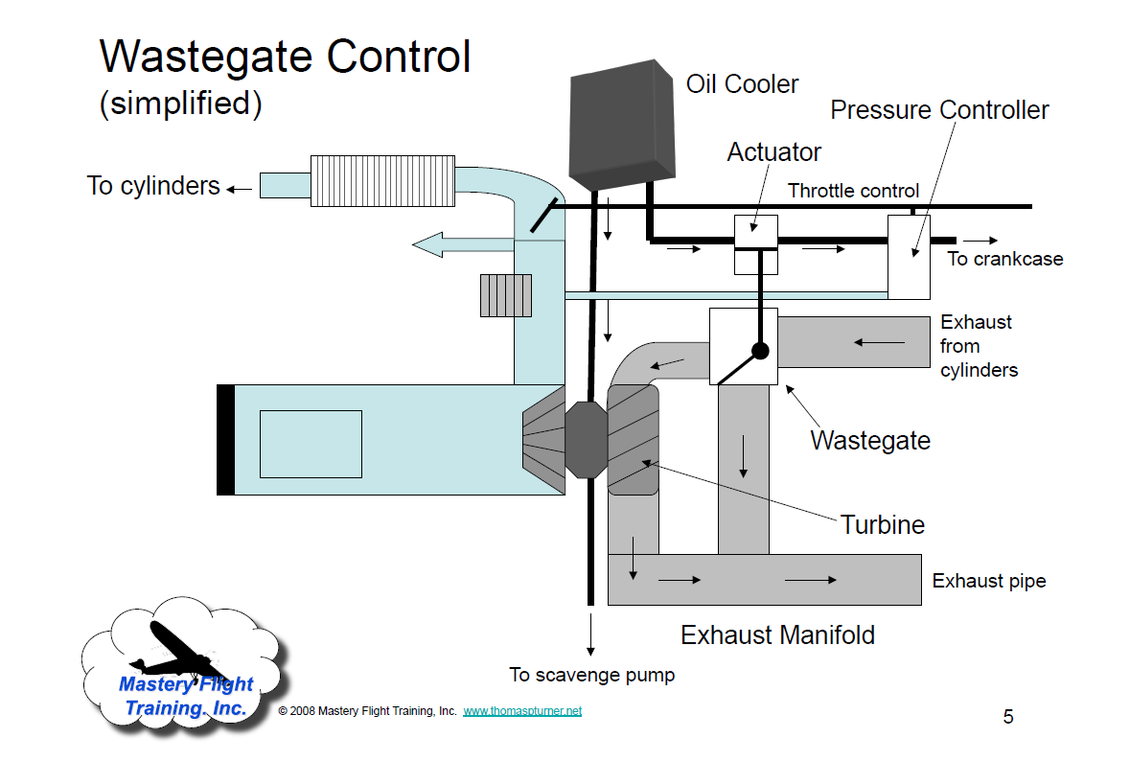

Slide 6
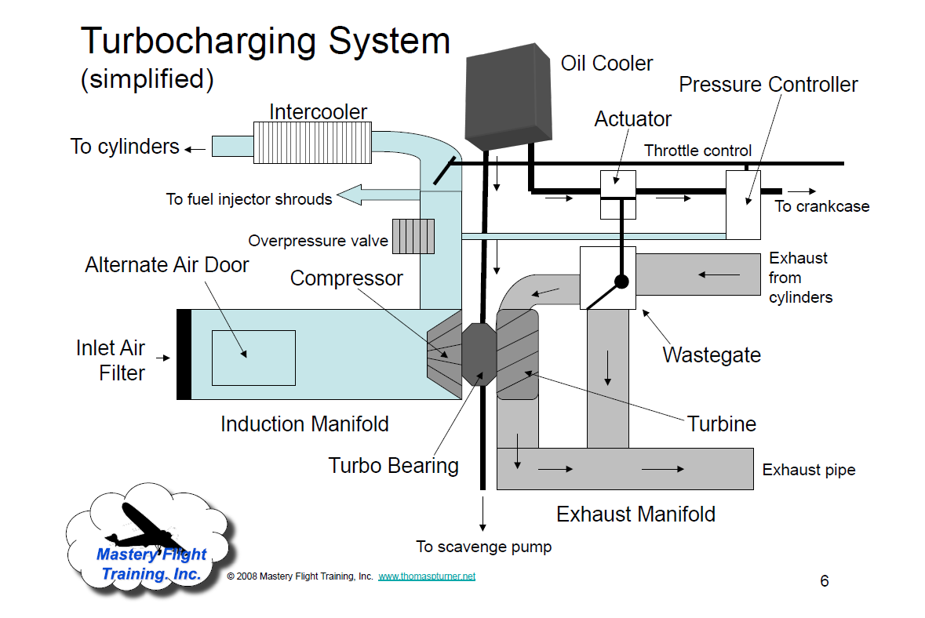

Slide 7
Additional Slides
On flying turbocharged aircraft

Slide 11
Mixture knob response to turbocharger failure

Slide 15
From T206H POH

Slide 16
From T206H POH

Slide 17
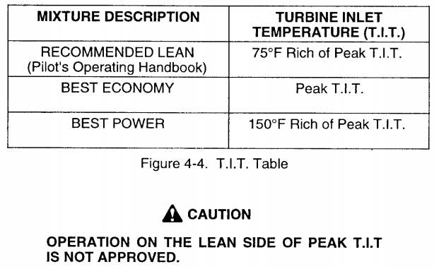

Slide 18
Additional Concerns To Have in Mind
Higher operating temperatures require constant monitoring of CHT, EGT and TIT
Leaning increases the CHT, EGT and TIT significantly and rapidly.
Shock cooling and proper descent planning
Allow for cool down after landing. Engine oil lubricates the turbine and impeller. Refer to the engine's operator manual (see syllabus)
Weight and Balance: 200- 250 lbs heavier
Improper starting procedures and engine fires
Turbocharger failures and loss of engine power at rich mixture setting

Slide 19
Additional Concerns (2)
Manual Wastegate (found in retrofits) – Overboost
Oil-pressure closes the wastegate Low oil-pressure and cold oil prevents wastegate to open and the engine from developing full take off power
Engine oil lubricates the turbine spinning at 30,000rpm at take off.
Apply power smoothly and slowly to prevent surge and overboost
100 octane required because of higher operating temperatures, lower octane causes detonation.
Long taxi watch temperatures
Run up and hold short, turn into wind

