Slide 1
Introduction to the Cessna 206
Capt Louise Mateos
1st Lt Michael Gross
Courtesy of LtCol Coby Sena

Slide 2
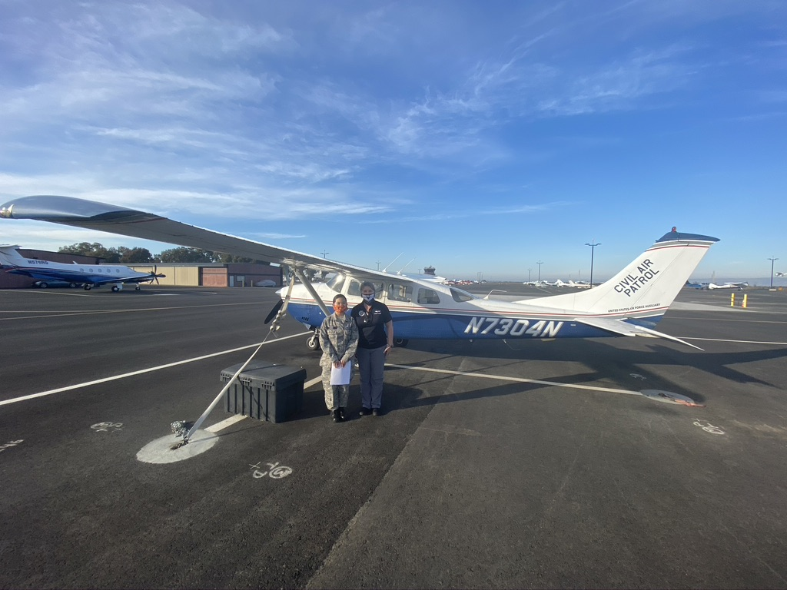
N7304N 1976 Cessna U206G, SN: U20603607
U206G
Stationair Stationair II
U20603522 thru U20604074
Continental IO-520-F 300 HP @ 2850 RPM (TO) 285 HP @ 2700 RPM (cont)
Notes:
Currently located on taxiway J, between R and Q, across from the hangars.

Slide 3
Performance Specifications (Ref: POH)

Slide 4
Some Structural Specifics
Ailerons – Differential and Frise design
Differential refers to the larger angle of travel in the up position than in the down position, increasing the drag on the down-going wing
Frise-type ailerons are constructed so that the forward part of the up-going aileron protrudes into the airstream below the wing to increase the drag on the down-going wing.
Both features act to reduce the effect of adverse yaw, thus reducing the required rudder input during balanced turns.

Slide 5
More Structural Specifics
Flaps
Single slot, fowler type flaps.
Single-slot allows the flap surface to maintain laminar flow longer
Fowler type design increase the surface area of the wing when extended
Maximum flap defection is 40 degrees
0-20 degrees for normal takeoff
20 degrees for maximum performance takeoff
Full flaps for normal approaches provides better handling in the flare, smoother transition to landing attitude and speed, and lower touch down speed.
Notes:
Cross wind landings
Lower flap settings can be used until experienced in the behavior and handling of the plane.
Up to 20 degrees – will cause higher touchdown speeds, but can increase lateral stability and control against drift.
Full flaps can be used in moderate to strong cross winds depending on pilot experience and comfort. Should only be practiced dual until sufficient competence is developed.

Slide 6
Maximum Weights
Ramp weight – 3612 lbs
Takeoff weight – 3600 lbs
Landing weight – 3600 lbs
6 person plane with 4 seats
Very difficult to overload
We do have ~ 75 lbs of stuff in the back.

Slide 7
Airspeed Limitations (Ref: POH)
Notes:
Flap a/s limitations specific to flap deployment
Maneuvering speed – awareness for the weight range we generally operate at with only 2 persons, fuel, and CAP equipment in plane

Slide 8
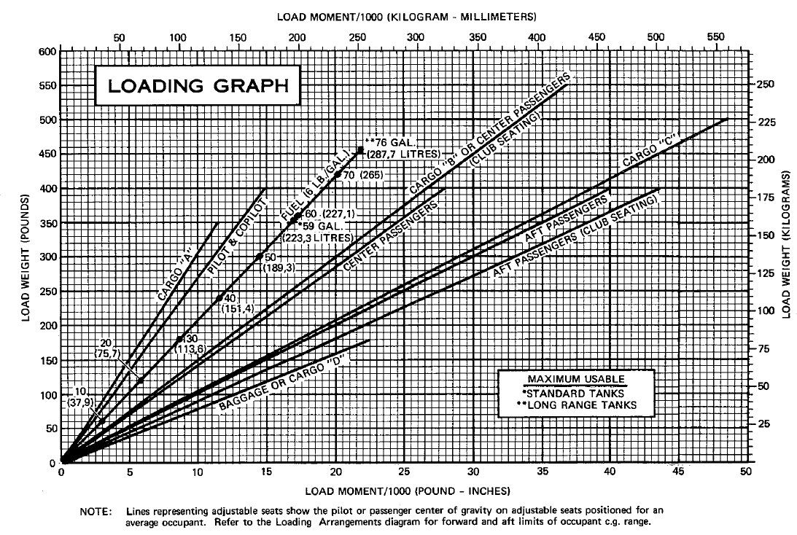
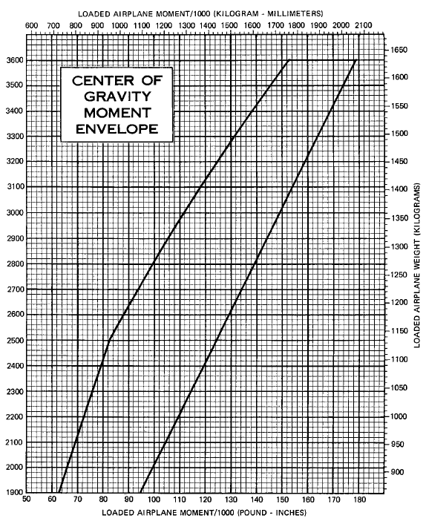
Weight and Balance Considerations (Ref: POH)
Notes:
Normally fill to full fuel
Tendency to have a forward CG with only two passengers – increases as fuel is used
More difficult to flare on landing

Slide 9
Power Plant Considerations (1 of 4)
Continental IO-520-F 300 HP @ 2850 RPM (TO) 285 HP @ 2700 RPM (cont)
2700-2850 RPM limited to 5 minutes
2550 RPM normal ops (top of green)

Slide 10
Power Plant Considerations (2 of 4)
Max power fuel flow placard

Slide 11
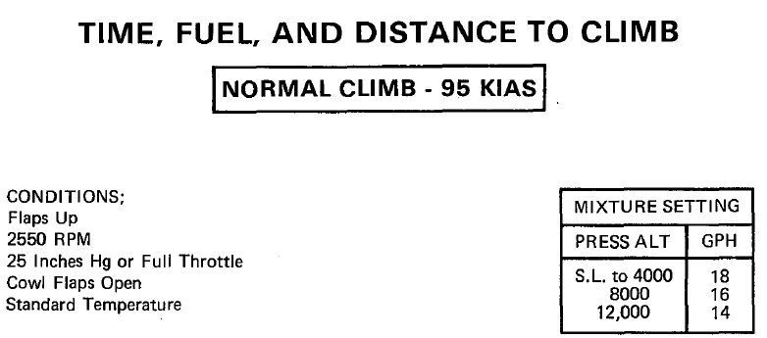
Power Plant Considerations (3 of 4)
Cruise climb recommended settings
25” MP and 2550 RPM at 95-105 KIAS
Fuel flow 18 gph up to 4000’
Per climb chart above 4000’

Slide 12
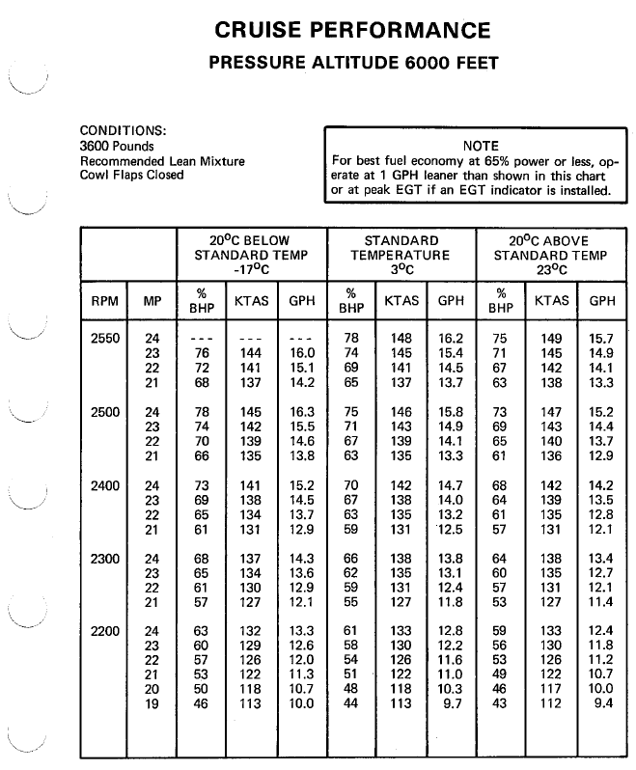
Power Plant Considerations (4 of 4)
Cruise performance and fuel flow settings
Temperature management of cylinders
Keep below 400° CHT temp
At high power settings EGT temp can exceed 1500° which is normal
Fuel tanks must be switched
Right or Left (no “both”)
Performance similar to C182 above 7000 density altitude

Slide 13
Recommended Settings for All Phases of Flight
Operation | Manifold Pressure | RPM | Fuel Flow
Take-off | 27 | 2850 | 24
Climb out | 27 | 2700 | 23
Cruise climb | 25 | 2550 | 16-17
Cruise | 22 | 2200 | 12-14
Fast cruise | 25 | 2550 | 16-17
Downwind – 90kts | 15-17 | 2200 | 10
Downwind – 100kts 10 flaps (ES patterns) | 15-17 | 2550; (or prop full) | 10-12
Precision Approach (550fpm) | 12 | (2700 touch & go); 2550 | Rich
Non- prec Approach | 10 | (2700 touch & go); 2550 | Rich
Missed Approach | 25 | 2550 | 16-17
Steep turn | 17 | 2550 | 12-14
Slow Flight (45-50kts) | 12↑22 | 2550 | 12
Power on stall | 22↓12↑22 | 2550 | 14-16
Power off stall | 12↑25 | 2550 | 14
Power off stall (ldg) | ↓12 | 2550 | 14

Slide 14
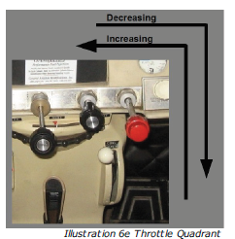
Additional Power Plant Considerations (1 of 2)
Power increase and decrease
Use the ‘7’ flow

Slide 15
Power Plant Considerations (2 of 2)
Descent planning should be done with two factors in mind
Speed management
Engine temperature management
Both can result in costly maintenance if not managed properly
Notes:
Note that descent into PAO should account for need to glide across bay if engine is lost—make sure not to descend too early and cross at the “train bridge” (narrowest point).

Slide 16
Power plant Considerations
Allow sufficient time for the descent
Too little time can result in:
Over-speed during descent which can result in structural damage
Large reductions in power to manage speed which can result in shock-cooling of the engine
20 inches MP does not reduce speed that much
Reduce BEFORE descent

Slide 17
Power plant Considerations
Good rule of thumb:
Allow 5 miles or 2 minutes per 1000’ and 1” MP
Shallow descents and gradual power reductions prevent over-speeding and allow you to arrive in the pattern at the appropriate approach speed.
Hand flown approaches at 150 knots can be “interesting” (no autopilot installed)
Do not set prop to full until it is already at fine pitch
Even though the checklists say otherwise
Drag is very, very substantial
Notes:
500 fpm descents are most comfortable too.
If you forget about the prop note, first time you put full prop will ”remind” you. Maybe do it after checking your seatbelts are secure.

Slide 18
Special Preflight Items
182 flow doesn’t quite work because flaps don’t go down when the right door is open. Check fuel first.
Fuel reservoir drains are not on the preflight checklist
Recommend sumping both reservoirs
The alternator belt can (should) be checked
It’s right behind the oil dipstick on the back of the engine
This plane has a history of repeated alternator belt failures
If you can turn the alternator by hand without the propellor moving, ground the plane
Notes:
There is a step ladder in the back of the plane. Make sure to secure it before closing the cargo door.

Slide 19
Starting Procedures
Fuel injection startup procedures
1. Mixture -- RICH.
2. Propeller -- HIGH RPM.
3. Throttle -- CLOSED.
4. Auxiliary Fuel Pump -- ON.
5. Throttle -- ADVANCE to obtain 8-10 gph fuel flow (full throttle, wait), then return to CLOSED position.
5.5 close immediately if warm, wait ~5 sec if near freezing
6. Auxiliary Fuel Pump -- OFF.
7. Propeller Area -- CLEAR.
8. Ignition Switch -- START.
9. Throttle -- ADVANCE slowly.
10. Ignition Switch -- RELEASE when engine starts.
10.5 Turn on fuel pump momentarily if it starts to die (slightly underprimed)
11. Throttle – 1000 RPM.
12. Oil Pressure -- CHECK.
13. Check ammeter and engine analyzer
Notes:
Different from the starting procedure for the G1000 C182.
Throttle must be advanced slowly because the engine will start as soon as the proper mixture of fuel and air is reached. Advancing the throttle too quickly can miss this point.

Slide 20
Flap Operation and Cargo Door
The U206G utility door contains a safety switch which disables the flap operation if the door is open.
In an emergency situation, DO NOT open the utility door until after the desired flaps are deployed.
After the flaps are deployed, open the door as follows:
Rotate forward cargo door handle full forward and then full aft
Open forward cargo door as far as possible
Rotate red handle in rear cargo door forward
Force rear cargo door full open
Notes:
Recommend new crew members practicing this on the ground at least once.

Slide 21
Normal Operation Considerations (1 of 3)
Power off stall procedures
Should have all flaps deployed by 1.3Vso
Very little buffeting
Audible stall warning 10kts prior to stall
Pronounced wing drop if uncoordinated at point of stall
Controls don’t mush like 182; stall is sudden

Slide 22
Normal Operation Considerations (2 of 3)
Power on stall procedures
Do not allow the plane to climb when setting up for the stall
Establish the stall attitude prior to adding power
Slow to rotation
Continue pull for pitch up
Then add power
Stay well behind the power curve (65 knots)
Use a maximum of 65% power (21/2550; 20/2550 above 8000)

Slide 23
Normal Operation Considerations (3 of 3)
Landings
Power management is key
Stabilized approach with power at 65 kt/full flaps
Nose heavy (be careful not to three-point)
Loss of inertia
Improper flaring = stall (suddenly), possible tail strike
Little ”mush” unlike 182
High drag; little floating

Slide 24
Emergency Operation Considerations (1 of 2)
Engine out procedures
IMPERATIVE – join downwind abeam at TPA from an orbiting descent
Turn IMMEDIATELY towards the landing area
DO NOT extend more than 10° flaps until landing is assured
It’s more like an Arrow than 182. Glide ratio 7:1
Notes:
This works fine.

Slide 25
Emergency Operation Considerations (2 of 2)
Engine out procedures
Straight in without power is unlikely to make the field (landing area)
Descent rate with power off much higher than 182
Energy management is critical
It is critical that airspeed be maintained throughout the procedure – glide, approach, and into the flare and landing
Power off, approach speed is higher – 80 knots dirty
Note your sight picture when practicing; it is quite steep, especially power off with flaps

Slide 26
CAP Approved Checklists
The CAP national website provides a link to approved normal and emergency checklists for each CAP aircraft by tail number.
https://www.capnhq.gov/CAP.ORMS.Web/ACFCHecklist.aspx
Some procedures on the approved checklists for N7304N differ from the procedures contained in the aircraft POH.
Significant difference in the engine failure in flight sections.
Notes:
The POH procedures are less detailed. The checklists reflect changes to procedures developed over the years and more closely resemble the procedures for the later 206G models. No Emergency Procedures checklist is currently listed in O.R.M.S., so use the one in the aircraft.

Slide 27
CAP Approved Checklist
ENGINE FAILURE DURING FLIGHT (POH)
Airspeed — 75 KIAS
Fuel Selector Valve and Quantity — CHECK
Mixture — RICH
Auxiliary Fuel Pump — ON for 3-5 seconds with throttle 1/2 open; then OFF
Ignition Switch — BOTH (or START if propeller is stopped)
Throttle — ADVANCE slowly

Slide 28
CAP Approved Checklist
Engine Failure During Flight (Restart) (CAP checklist)
Airspeed — 75 KIAS
Auxiliary Fuel Pump — On
Fuel Selector Valve — Opposite Tank (if it contains fuel)
Throttle — Half Open
Auxiliary Fuel Pump — Off
Note
If the fuel flow indication immediately drops to zero, signifying an engine-driven fuel pump failure, return the auxiliary fuel pump switch to On.
Mixture.....Lean from full rich until restart occurs
Note
If propeller is windmilling, engine will restart automatically within a few seconds. If propeller has stopped (possible at low speeds), turn ignition switch to Start, advance throttle slowly from idle, and (at higher altitudes) lean the mixture from full rich.
Mixture — Adjust as required as power is restored
Throttle — Adjust power as required
Fuel Selector Valve — As Desired after fuel flow is stabilized

